Slide 1

Fresher Android
Jetpack Architecture Component 2
5/6/2020
09e-BM/DT/FSOFT - ©FPT SOFTWARE – Fresher Academy - Internal Use
1

Slide 2

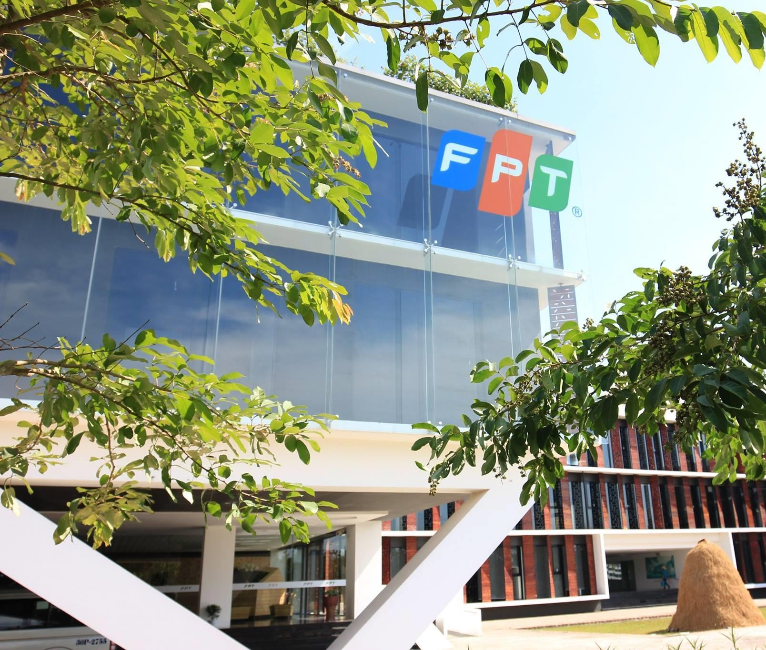




Navigation overview
Confidential ²

Slide 3
Navigation Overview
Navigation refers to the interactions that allow users to navigate across, into, and back out from the different pieces of content within your app
The Navigation component consists of three key parts that are described below:
Navigation graph: An XML resource that contains all navigation-related information in one centralized location. This includes all of the individual content areas within your app, called destinations, as well as the possible paths that a user can take through your app.
NavHost: An empty container that displays destinations from your navigation graph. The Navigation component contains a default NavHost implementation, NavHostFragment, that displays fragment destinations.
NavController: An object that manages app navigation within a NavHost

Slide 4
Principles of Navigation
Starting point – visible when application is started from a launcher, it's the last screen
after returning by pressing back button
Navigation state is represented by a stack (start destination at the bottom, current destination at the top of the stack)
Up button takes user to hierarchical parent destination, never exits the app
Up button function identically to the system Back button in your own app's task
(when back button would not exit your app)
Deep link to a destination has got the same stack as it would be by navigating from start destination (user is able to use Back or Up buttons to navigate
through destinations back to the start destination). Any existing navigation stack is removed and replaced with the deep link's navigation stack

Slide 5
Set up environment
Confidential ⁵

Slide 6
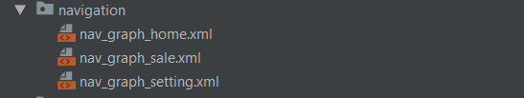
Setting up navigation in a project
Gradle:
implementation 'androidx.navigation:navigation-ui-ktx:2.1.0-alpha06' implementation 'androidx.navigation:navigation-fragment-ktx:2.1.0-alpha06'
Create a new resource file of type Navigation in res folder:
navigation resource directory is created
nav_graph.xml is created which contains navigation graph

Slide 7

Navigation in detail
Confidential ⁷

Slide 8
#1. Destinations
Destinations:
Activities
Fragments
Can be created in Editor as blank destination or from existing Fragments and Activities in our project
<navigation xmlns:android="http://schemas.android.com/apk/res/android" xmlns:app="http://schemas.android.com/apk/res-auto" android:id="@+id/nav_graph_sale" app:startDestination="@id/amountEntryFragment">
<!-- Screen Amount Entry input -->
<fragment android:id="@+id/amountEntryFragment" android:name="com.ingenico.uipresentation.fragment.AmountEntryFragment" android:label="AmountEntryFragment">
</fragment>
</navigation>

Slide 9
#2. Actions
Actions are scoped to the destination they are attached to the same action on a different destination can have different behavior.
It means the same action can have different destination it points
to and also different attributes like transition animations
<fragment
android:id="@+id/notesFragment" android:name="com.jshvarts.notesnavigation.presentation.notelist.NoteListFragment" android:label="@string/label_note_list" tools:layout="@layout/note_list_fragment">
<action
android:id="@+id/action_notes_to_addNote" app:destination="@id/addNoteFragment" />
<action
android:id="@+id/action_notes_to_noteDetail" app:destination="@id/noteDetailFragment" app:enterAnim="@anim/enter_slide_down" app:exitAnim="@anim/exit_slide_down" app:popEnterAnim="@anim/pop_enter_slide_up" app:popExitAnim="@anim/pop_exit_slide_up">
</action>
</fragment>

Slide 10
#3. Hosting navigation
An activity hosts navigation for an application through the implementation of NavHost interface - Navigation Architecture Component’s default is NavHostFragment. It is added to the activity’s layout.
<LinearLayout
android:layout_width="match_parent" android:layout_height="match_parent" android:orientation="vertical">
<fragment
android:id="@+id/nav_host_fragment" android:name="androidx.navigation.fragment.NavHostFragment" android:layout_width="match_parent" android:layout_height="match_parent" app:defaultNavHost="true" app:navGraph="@navigation/mobile_navigation" />
</LinearLayout>

Slide 11
#4. NavHostFragment
NavHostFragment swaps in and out different fragment destinations as user navigates through the
navigation graph.
Navigation graph is associated by navGraph attribute:
app:navGraph="@navigation/mobile_navigation"
To ensure that NavHostFragment intercepts the system Back button:
app:defaultNavHost="true"
To support Up button there is a need to overwrite
override fun onSupportNavigateUp(): Boolean {
return navigateUp(findNavController(this, R.id.nav_host_fragment), drawerLayout)
}

Slide 12
#5. Navigation Controller
Navigation to a destination is done by NavController class.
A NavController can be retrieved using one of the following static methods:
NavHostFragment.findNavController(Fragment)
Navigation.findNavController(Activity, @IdRes int viewId)
Navigation.findNavController(View)
View.findNavController()
navigate() method is used to navigate to a destination. It accepts ID of a destination or of an action.

Slide 13
#5. Navigation Controller
Useful methods:
NavController.navigateUp()
NavController.popBackStack()
They will be translated into appropriate framework operations.
For example when we navigate() to an activity destination, the NavController calls startActivity() on our behalf.
Pressing Up and Back button calls these methods respectively to pop the top destination off the stack.

Slide 14
#6. Transitions between destinations
Transitions can be easily added through XML or Attributes panel
<fragment
android:id="@+id/notesFragment" android:name="com.jshvarts.notesnavigation.presentation.notelist.NoteListFragment" android:label="@string/label_note_list" tools:layout="@layout/note_list_fragment">
<action
android:id="@+id/action_notes_to_addNote" app:destination="@id/addNoteFragment" />
<action
android:id="@+id/action_notes_to_noteDetail" app:destination="@id/noteDetailFragment" app:enterAnim="@anim/enter_slide_down" app:exitAnim="@anim/exit_slide_down" app:popEnterAnim="@anim/pop_enter_slide_up" app:popExitAnim="@anim/pop_exit_slide_up">
</action>
</fragment>
Or in code using NavOptions

Slide 15
#7. Passing data between destinations
Every destination can define what arguments it can receive.
Two possible ways of passing data between destinations:
using Bundle
type-safe way using safeargs Gradle plugin
To enable safeargs, add below line to build.gradle
apply plugin: 'androidx.navigation.safeargs.kotlin'

Slide 16
#8. Passing data – adding arguments
<fragment
android:id="@+id/editNoteFragment" android:name="com.jshvarts.notesnavigation.presentation.editnote.EditNoteFragment" android:label="@string/label_edit_note" tools:layout="@layout/edit_note_fragment">
<argument
android:name="noteId" app:argType="integer" />
</fragment>
Create Bundle and pass it to the destination using navigate() method. Enable safeArgs for easy
passing Data between fragment
apply plugin: 'androidx.navigation.safeargs.kotlin'

Slide 17
#9. Nested navigation graph
A series of destinations can be grouped into a sub-graph within a navigation graph.
Useful for organizing and reusing sections of app’s UI like a login flow.
Nested graph must have a start destination.
Root graph only accesses the nested graph through its starting destination
In navigation graph you can reference other graph by using <include>
<include app:graph="@navigation/nav_graph_sale" />

Slide 18
#10. Deep linking to a destination
Deep links allow to jump in the middle of app’s navigation. It can be from an url link or pending intent.
Navigation library ensures users start on the appropriate destination with the appropriate back stack.
When user uses the Back button they navigate back up the navigation stack just as though they entered app from app’s entry point.
When deep link is triggered, the task back stack is cleared and replaced with the deep link destination.

Slide 19
Lesson Summary
Navigation Overview
Setup environment
Navigation in detail
5/6/2020
09e-BM/DT/FSOFT - ©FPT SOFTWARE – Fresher Academy - Internal Use
19

Slide 20

Thank you
5/6/2020
09e-BM/DT/FSOFT - ©FPT SOFTWARE – Fresher Academy - Internal Use
20

